Slide 1
Emf induced in armature coil
Fig. 13 shows flux distribution over 2 pole-pitches of 2p-pole machine.
The spatial distribution of the gap flux is sinusoidal.

Slide 2
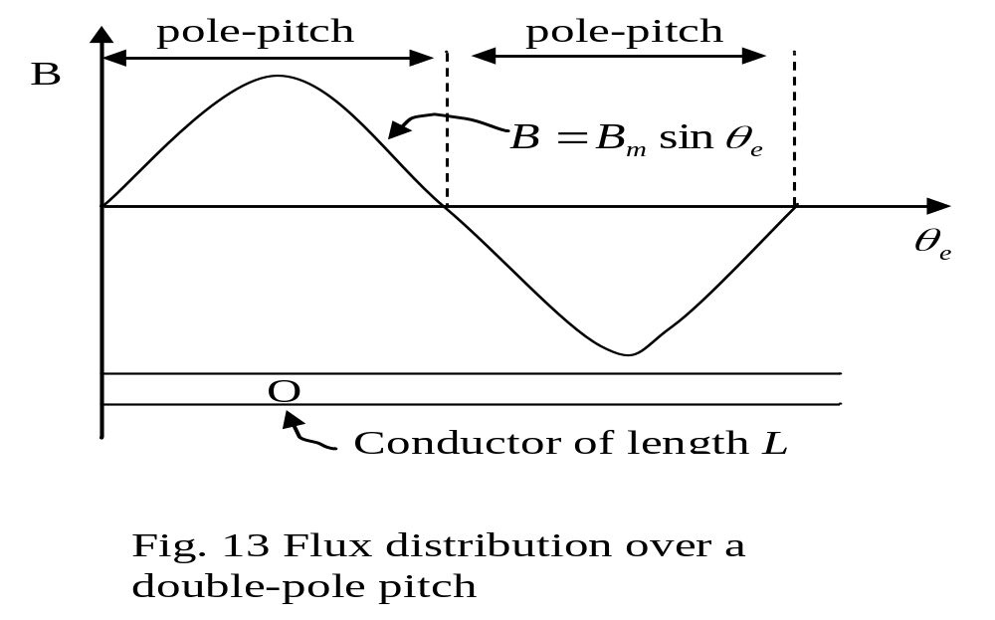

Slide 3
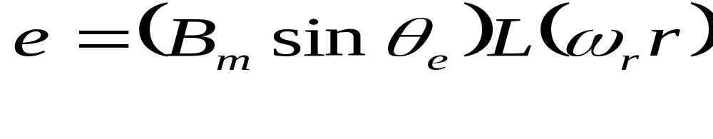
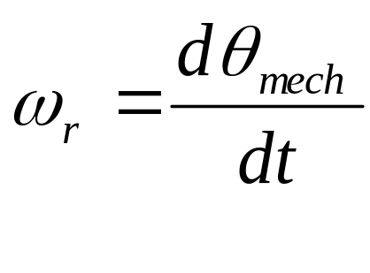
The flux is supposed to be stationary and the conductor is supposed to be moving past it at speed u = ωr
The voltage induced in the conductor is
The angular velocity

Slide 4
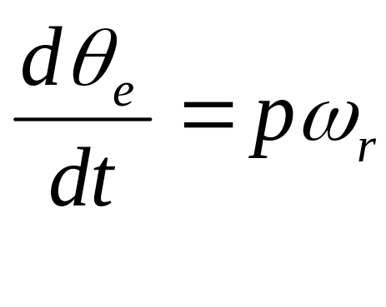
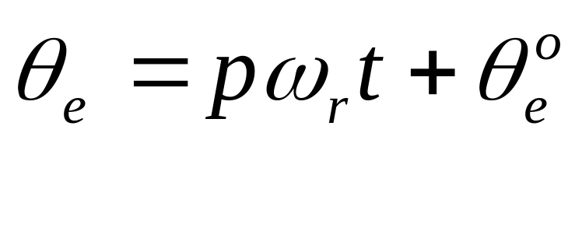
Hence
Suppose that the conductor is located at θ_{e} = θ_{e} º when t = 0.
Then its location at the time t is

Slide 5
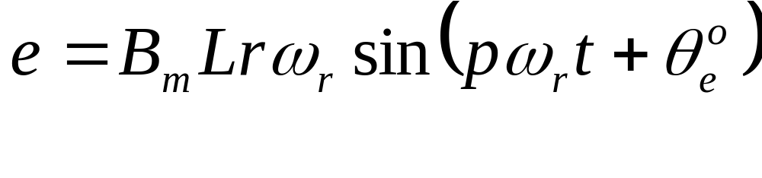
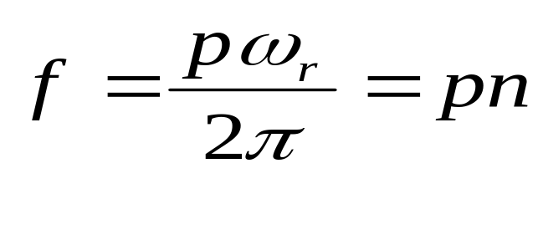
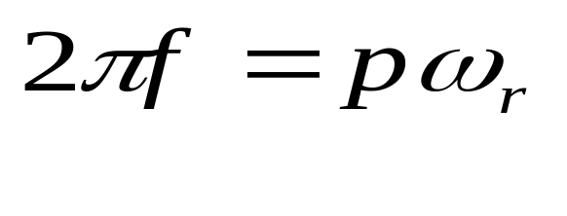
Substituting this in the emf equation gives the steady-state voltage as a function of time as
Let Then
n is the speed of the conductor or armature in rev/s

Slide 6
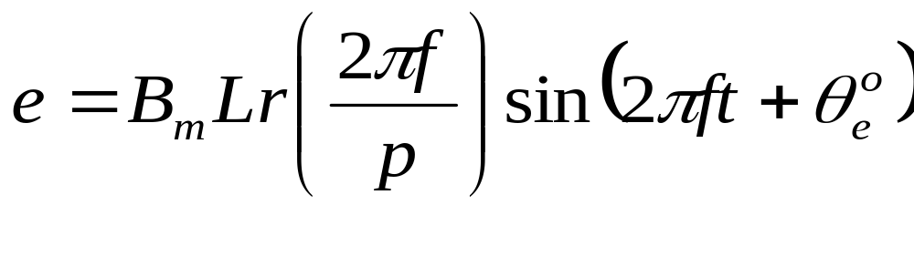
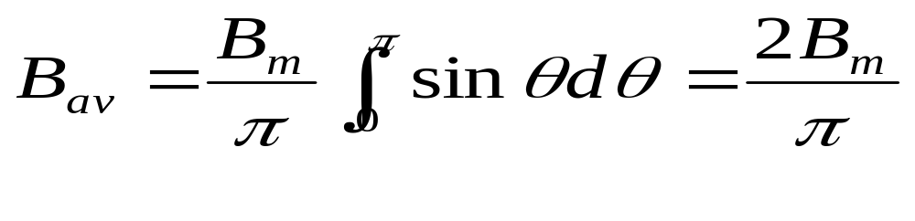
If we substitute this into
we obtain
The average density in the air gap

Slide 7
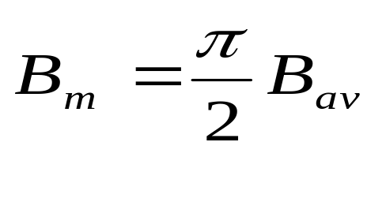
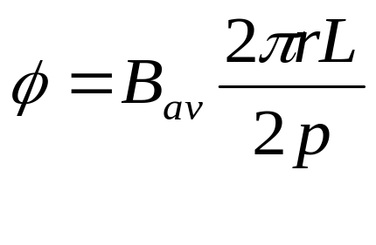
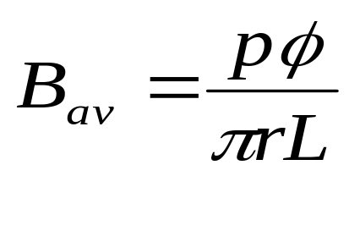
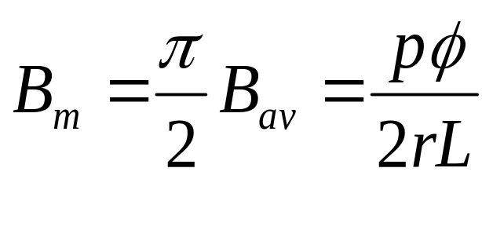
From which
Total flux per pole
from which
Therefore

Slide 8
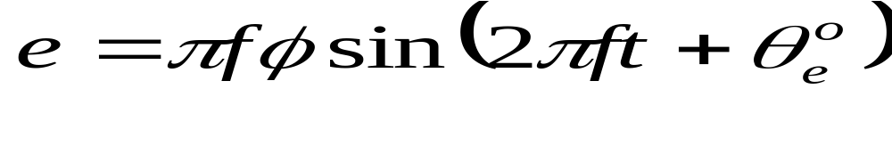
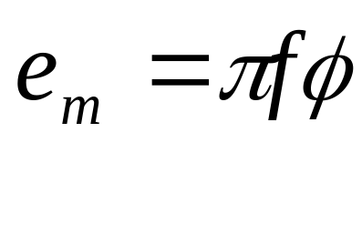
Substituting this into
yields
The peak emf of a conductor

Slide 9
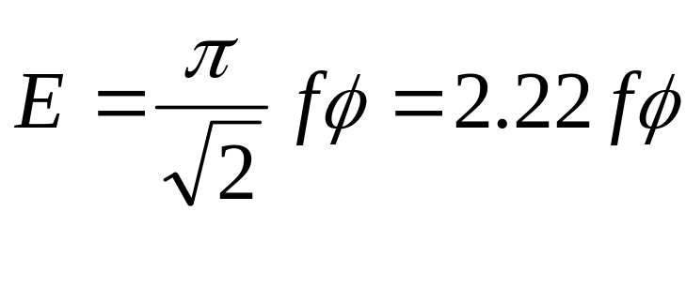
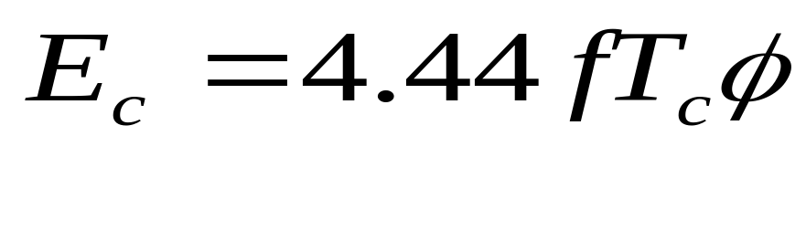
The rms value
For a coil of T_{c} turns the number of conductors = 2T_{c}
Therefore for a full-pitch coil of T_{c} turns the rms coil emf is

Slide 10
Winding factors
Distribution factor
The coil voltages all have the same magnitude and frequency but they are not in phase with each other. (Because their θ_{e} zeroes are different)
The emf of a phase or coil group is the phasor sum of the constituent individual coil emf.

Slide 11
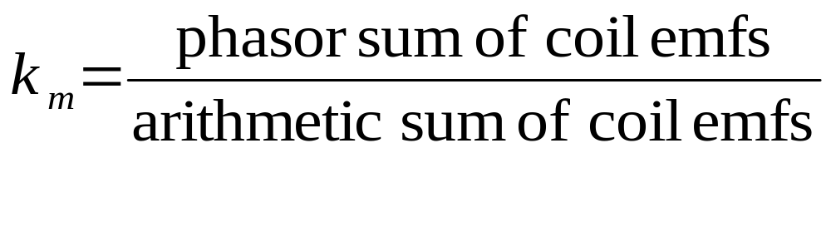
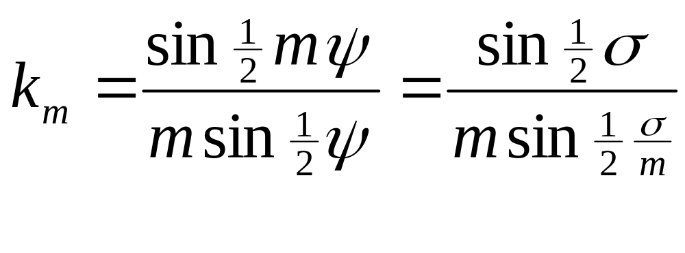
The distribution factor is defined as
Suppose a phase group to comprise m full-pitch coils and the slot angle is ψ . Then

Slide 12
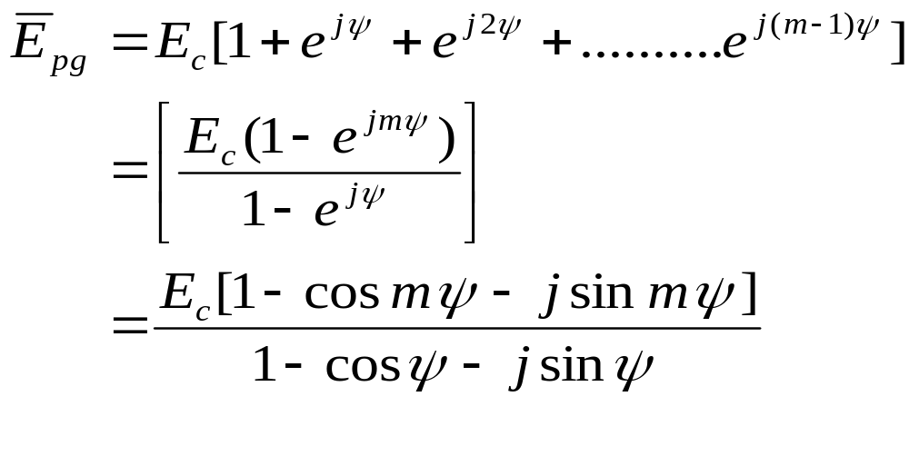
Proof
  The phasor sum

Slide 13
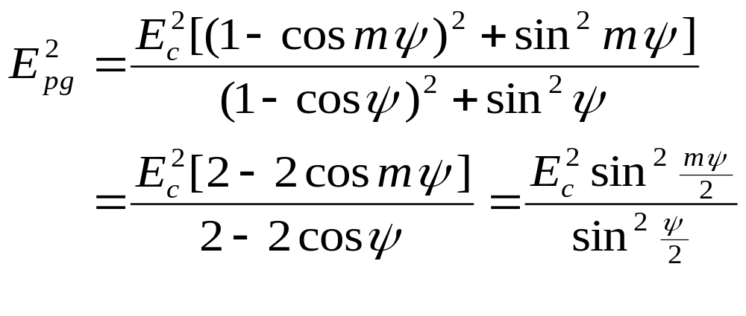

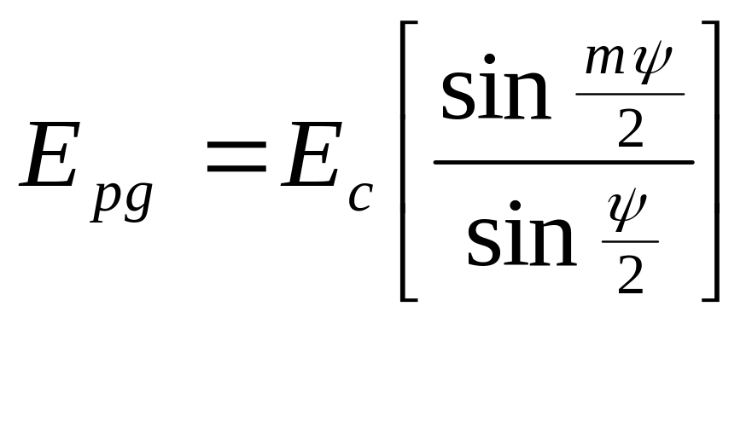

Slide 14
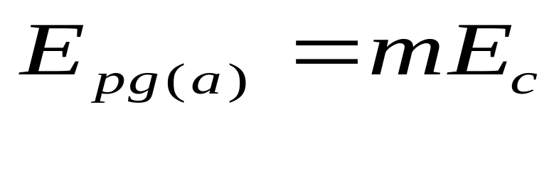
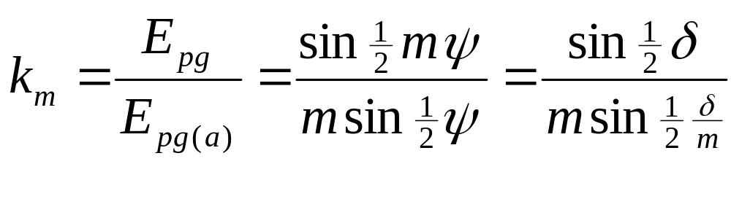
Arithmetic sum
The distribution factor

Slide 15
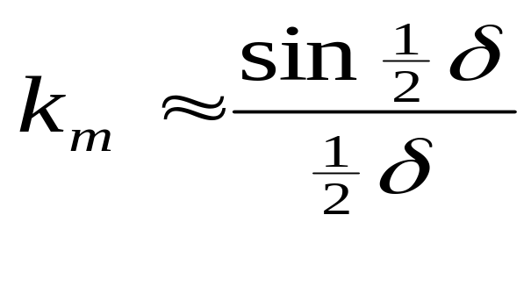
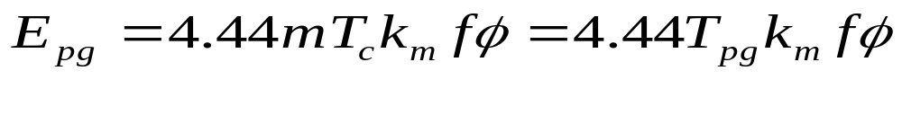
When ψ is small. Then
The phase group of the m full-pitch coils will produce the rms emf
where T_{pg} = mT_{c} is the total turns in series per phase group.

Slide 16
Coil span factor
A coil may be under- or over-pitched. Such a coil is said to be chorded.
A coil is usually short-pitched.
Short-pitched coils have amount of copper in the end-connections reduced and harmonics in the phase emfs reduced or suppressed.

Slide 17
A coil pitch of 0.8 to 0.9 per unit is usually employed on 2-layer windings and this reduces the 5th and 7th harmonics considerably.
Fig. below shows the arrangement of phase A conductors in a 2-layer, 60º winding over two pole-pitches.
There are 6 slots per pole or 2 slots per pole per phase (= m).

Slide 18
The arrangement W is for full pitch coils and the arrangement Z is for short-pitched or chorded coils.
The chorded coils are short-pitched by 1 slot interval which corresponds to ε = 180/6 = 30º electrical

Slide 19
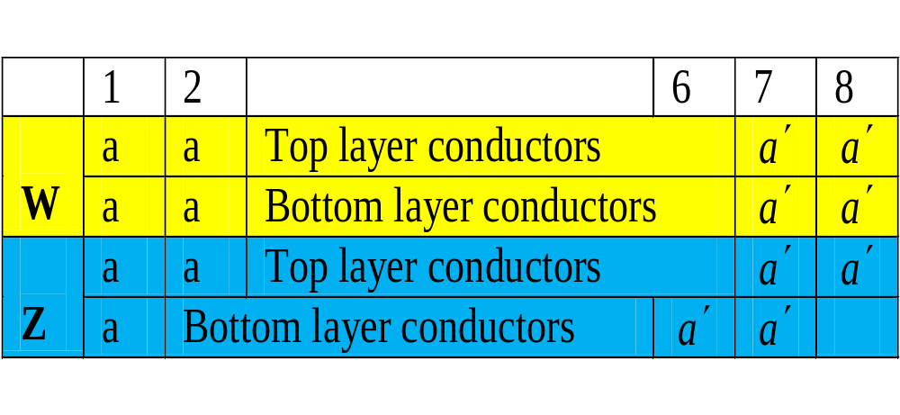

Slide 20
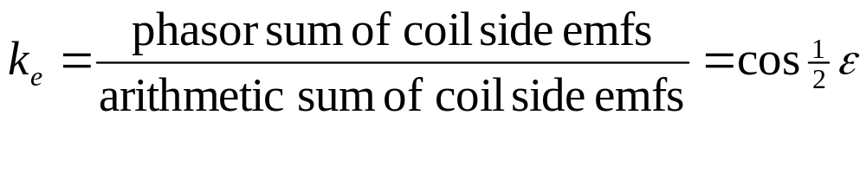
If the coil span is not a full pitch, then the voltage of a coil is given by the phasor sum of the conductor emfs in its two sides.
Let the coil span depart from its full-pitch value by ε electrical degrees. Then the coil-span factor

Slide 21
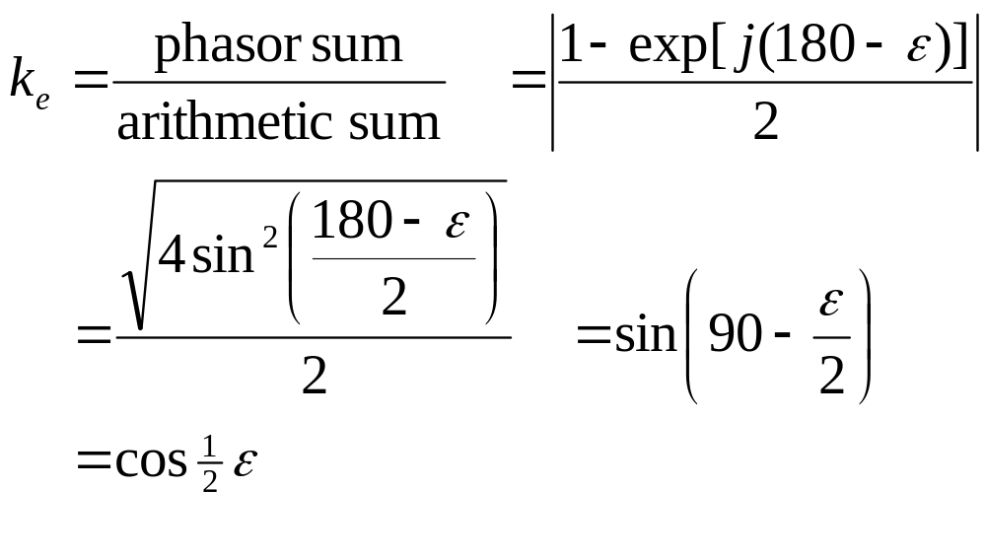
Proof

Slide 22
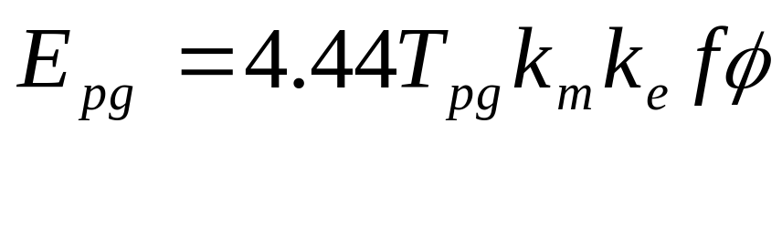
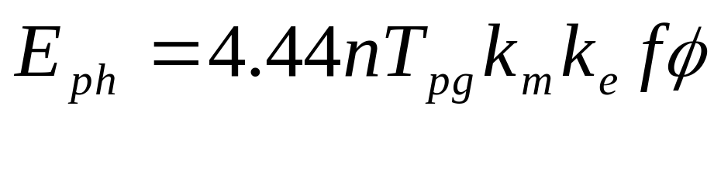
Phase winding emf
A phase or coil group consisting of short-pitched coils will produce the rms emf
A phase winding consisting of such n phase groups in series will have a phase voltage

Slide 23
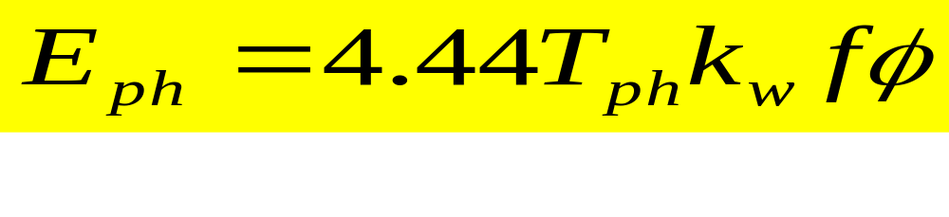
Or
where
T_{ph} is the total turns in series per phase and
k_{w} = k_{m}k_{e} is the winding factor.

Slide 24
  Harmonic voltages
The gap-flux density curve which is not purely sinusoidal can be analysed into fundamental and harmonic densities B₁ , B₃, B₅, B_{7,} , , , etc.
The emf of a phase due to n^{th} harmonic is

Slide 25
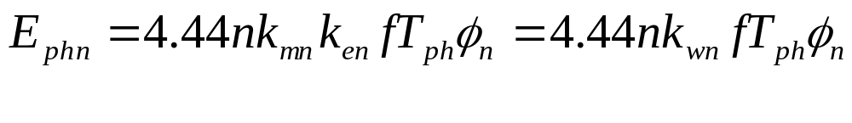
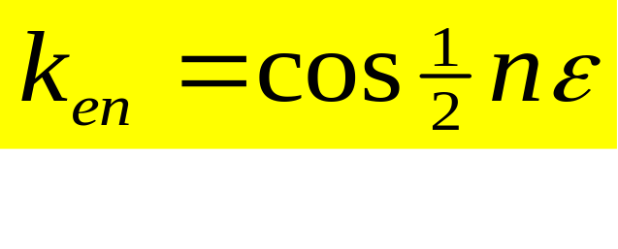
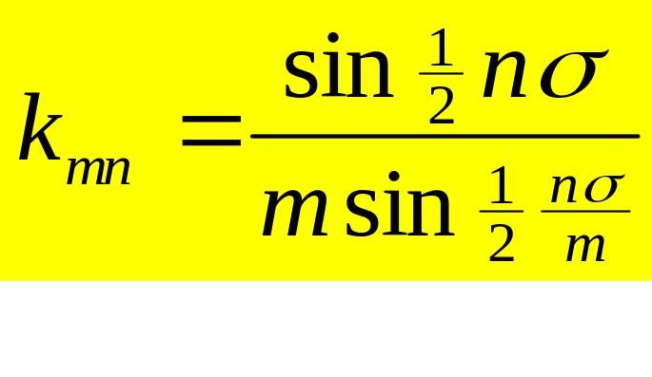
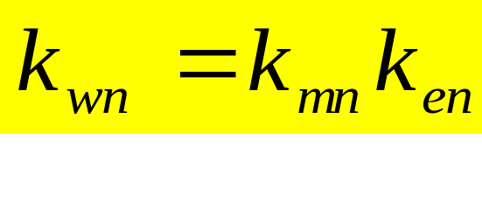
where ,
and

Slide 26
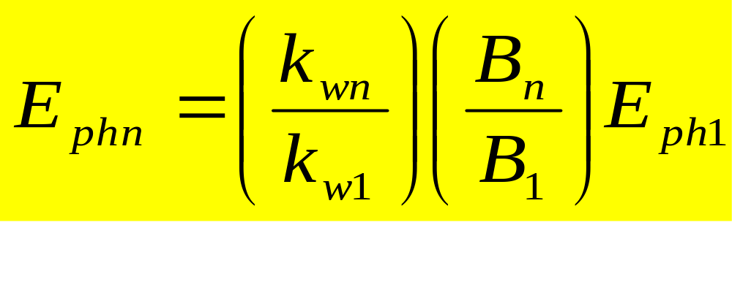
A more useful form is
The subscript 1 refers to the fundamental component of the flux.

Slide 27
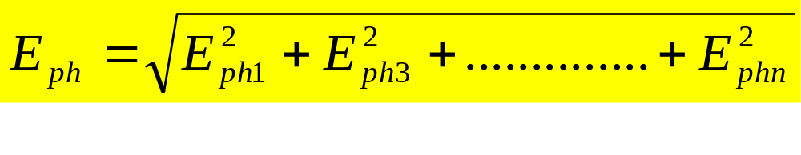
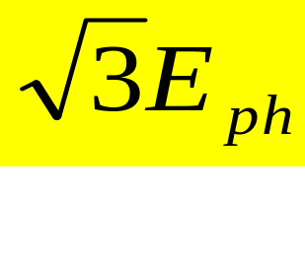
The rms phase emf in this case will be
The line emf in star connection is
with E_{ph} calculated as above but omitting all triplen (i.e. all odd multiples of 3) harmonic values.

